Slide 1


The Blimp
1. Given a pose in the world
2. The blimp estimate its state
(12 states included position, rotation, and accelerations)
3. Then move towards the pose with the control unit (micro-controller, motor controller, and motors)

Slide 2
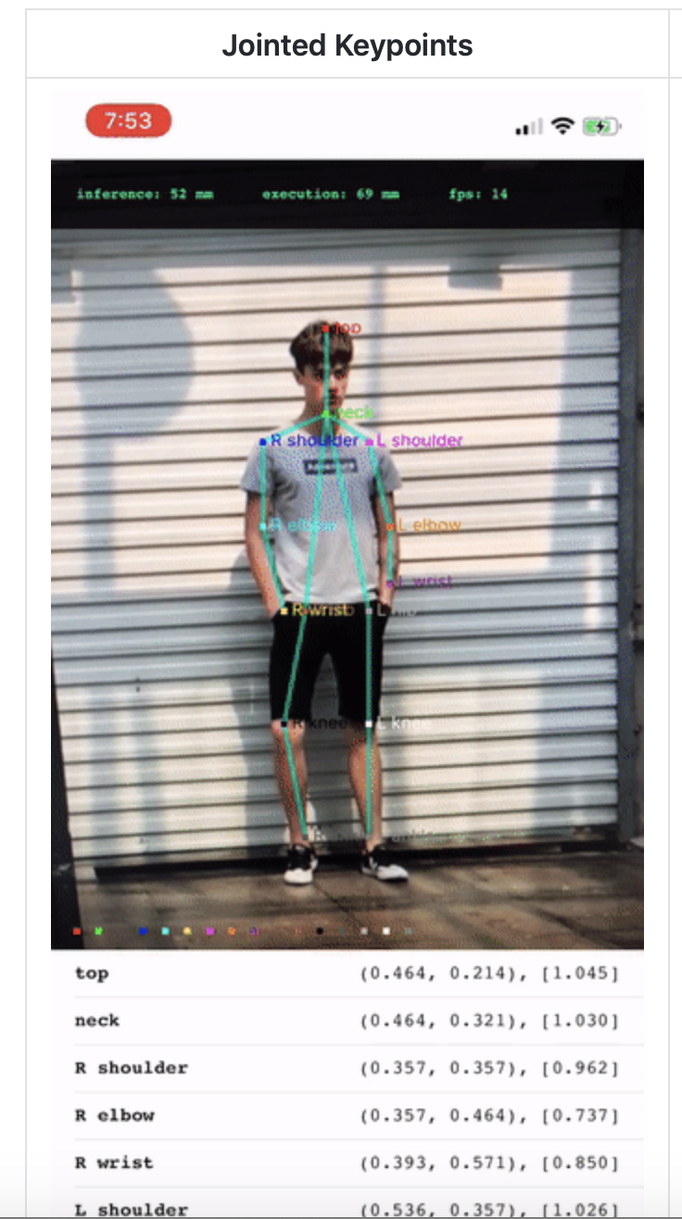
IMPLEMENTING POSE ESTIMATION CODE ON THE PHONE - Swetha
Next Steps:
Articulating how many cameras we’re using and how many people each camera is supposed to detect
Relaying the coordinate information from the phone to the server and blimp
Possible Method: add a section of code in the XCode script which can convey the coordinate information to a module file in the Python repository
Currently able to run the pose estimation code on IPhone 8 Plus using an open source PoseEstimation model built on XCode
Notes:
The big picture of the pose estimation:
Detect poses or limbs with phone camera pre-placed in the environment.
Then send the coordinate values to the perception unit through WIFI.

Slide 3
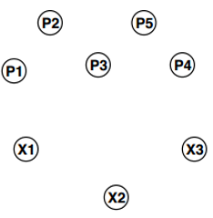
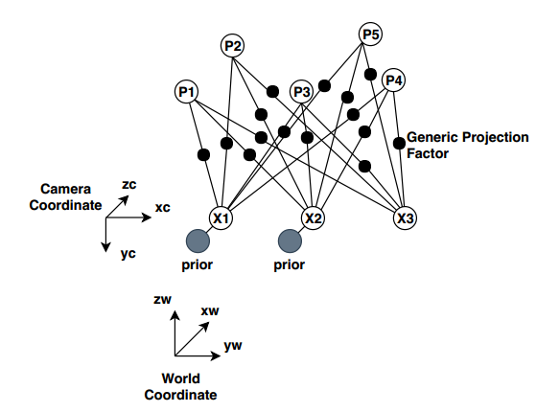
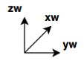
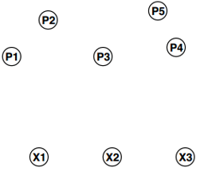
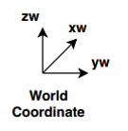
Offline Mapping: Stucture form Motion (SfM)
Input:
Features of corresponding Landmark Points (Pn) in images captured by camera at different poses (Xn).
Outputs:
Landmark Points and Camera Poses values in the world coordinate system.
Fig 2. Actual map output
Similarity Transform
Fig 3. Expected map output
Fig 1. Factor Graph of SfM
Notes:
The big picture of the perception:
Build a map offline, then estimate the state of the robot with the prebuild map, past trajectory, and input image.

Slide 4
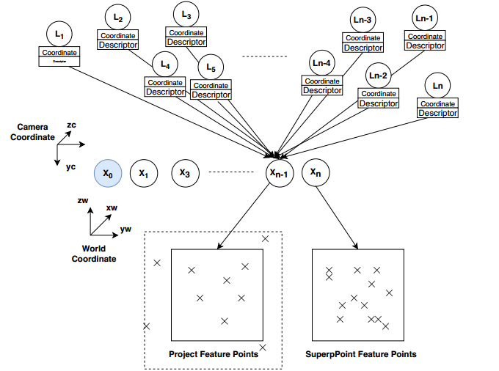
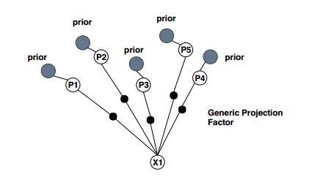
Real-time Localization: When a map is available a-priori then the problem becomes pose-estimation
Input:
Prebuilt Map
Past Trajectory
An image capture by a camera at the current pose
Output:
Current camera Pose values in the world coordinate system.
Correspondences
Pose3(x,y,x,row,pitch,yaw)
Feature Matching Based on
a. Coordinate Distance
b. Descriptor L2 Distance
Fig 7. Factor Graph for pose estimation
Fig 6. Trajectory Estimation Process

Slide 5
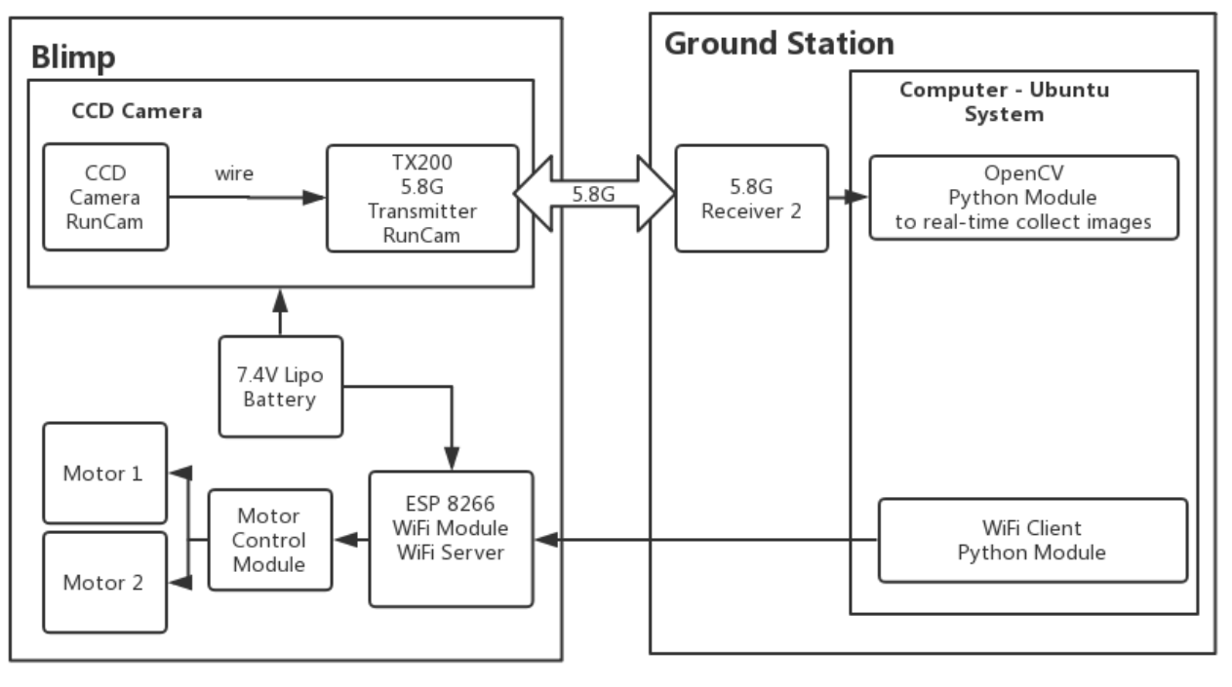
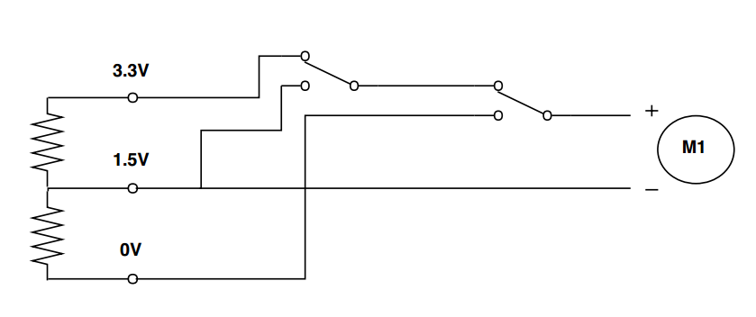
Control
Notes:
The big picture of the control is:
Generate motor input signals with the blimp state and the estimated pose coordinate values.

Slide 6
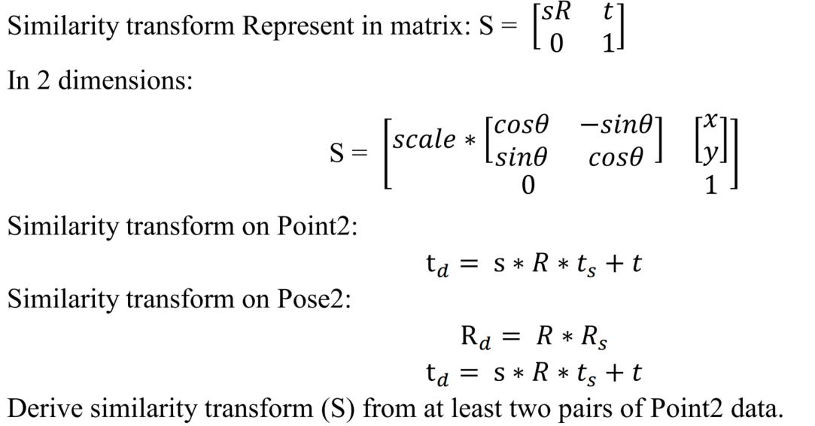
Similarity
Transform 2:
p3
p2
y
x2
y
p4
p3
(s,R,t)
p1
p2
p1
x
x2
p4
x1
x1
x
Fig 4. Sim2 Transform on 4 points and 2 poses
(x represents poses (pose2) and p represents points (point2))

Slide 7
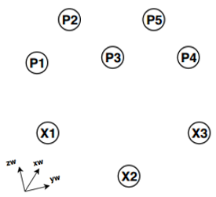
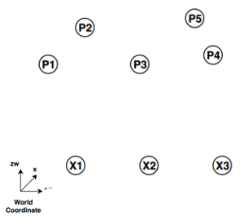
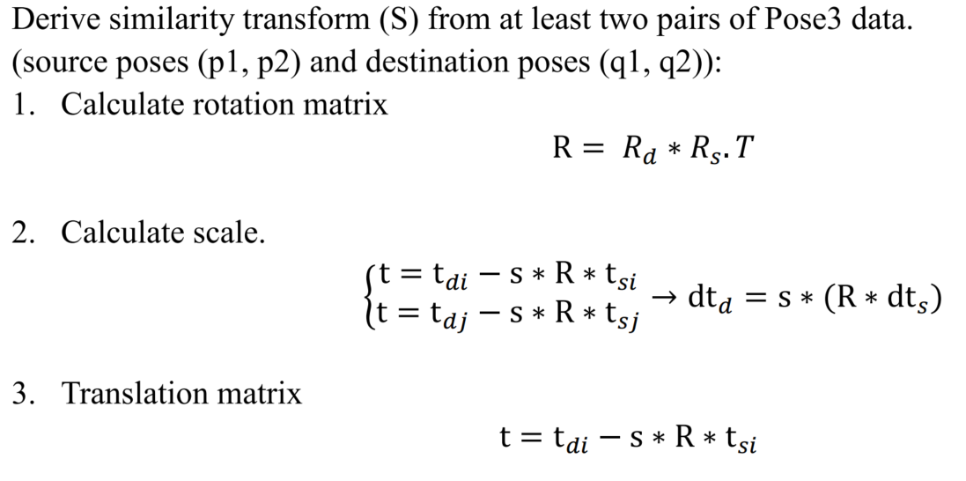
Similarity
Transform 3:
(s,R,t)
Fig 5. Sim3 Transform on 5 points and 3 poses

